Slide 1
Middleware for P2P architecture
Jikai Yin, Shuai Zhang, Ziwen Zhang

Slide 2
What is P2P?
Concept of a decentralized large-scale distributed system.
Large number of networked computers(peers).
Each peer has equivalent capabilities and responsibilities, merging the roles of client and server.
Data distribution over participants, no central authority.

Slide 3
Common P2P Applications
P2P File Sharing:
Napster, Gnutella, Kazaa, BitTorrent, Chord, CAN
P2P Communications:
MSN, Skype
P2P Storage:
OceanStore
P2P Distributed Computing:
Seti@home

Slide 4

Napster
First P2P file-sharing application
Based on central index server
Lookup is centralized, but files are copied in P2P manner.
Only sharing mp3 files (few MBs)
Pros: Fast., efficient and overall search & consistent view of the network
Cons: Central server is a single point of failure & Expensive to maintain the central server.

Slide 5

BitTorrent
Clients that download a file at the same time upload chunks to each other
BitTorrent Clients form a swarm: a random overlay network.
BitTorrent enables tit-for-tat : a client unchokes other peers (allow them to download) that allowed it to download from them.
Pros: Proficient in utilizing partially download files & Encourage diversity through “rarest-first”.
Cons: Assumes all interested peers active at same time & Performance deteriorates if swarm “cool off”.

Slide 6
What’s the problem?
Existing P2P solutions have had rapid adoption and success – so why build another?
Three key shortcomings for typical P2P systems:
Interoperability
Platform Independence
Ubiquity
Gnutella for file sharing, MSN for instant messaging
But none of them can talk to each other
Each P2P application has its own protocol and interfaces

Slide 7
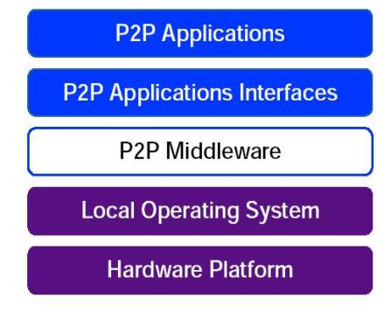
Solution
Enable a wide range of distributed computing applications by developing a common set of general purpose P2P protocols.
Platform independence-any language, any OS, any hardware
Minimal Hardware assumptions: enable new applications to run on any device that has a digital heartbeat

Slide 8
JXTA is a good solution
JXTA is a set of open XML-based protocols to build
Peer to Peer Applications

Slide 9
What is JXTA?
Interoperability
JXTA technology is designed to enable peers providing various P2P services to locate each other and communicate with each other.
Platform independence
JXTA technology is designed to be independent of programming languages, transport protocols, and deployment platforms.
Ubiquity
JXTA technology is designed to be accessible by any device with a digital heartbeat, not just PCs or a specific deployment platform

Slide 10
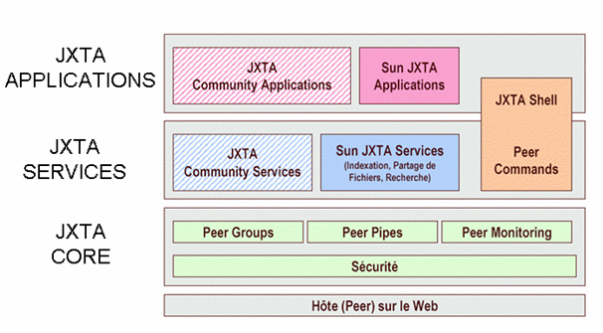
Architecture

Slide 11
Architecture (Cont’d)
Platform Layer, also known as the JXTA core, encapsulates the minimal and essential primitives that are common to all P2P environments. These include the creation of peers, peer groups and security primitives.
Service Layer. The Service layer includes the services that are not completely necessary for P2P networking, but are often used to make some tasks easier.
Application Layer. Implementations of integrated applications: i P2P instant messaging, document and resource sharing and P2P email systems.
Notes:
JXTA Core layer:This provides the basic classes or methods that are necessary to develop a p2p application.
JXTA Service Layer :This layer includes some services that may be used by the peers for some specific applications layer.
JXTA Applications layer:These are the P2P applications, which are built using the core and service layer features.

Slide 12
Peers
Peer is any networked device that implements one or more of the JXTA protocols.
Each peer operates independently and asynchronously from all other peers.
Uniquely identified with a Peer ID.
Peers publish one or more network interfaces for use with the JXTA protocols.
Intermediate peers may be used to route messages.

Slide 13
Peer Group
Collection of Peers that have agreed upon a common set of services.
Each Peer group is identified using a unique peer group ID.
Peers may belong to more than one peer group simultaneously.
All peers belong to the NetPeerGroup.

Slide 14
Peer Group Service
A set of services that are replicated through the whole peer group.
Root peer group has the following services:
Discovery Service: search for peer group resources.
Membership Service: Accept/deny new members.
Access Service: Validate requests
Pipe Service: Create / Manage pipe connections
Resolver Service: Send generic queries to other peers.
Monitoring Service: Allow one peer to monitor the other members of the same peer group.

Slide 15
Pipes
Virtual communication channel that may connect peers that do not have a direct physical link.
JXTA peers use PIPES to send messages to each other.
Pipes are an asynchronous and unidirectional message transfer mechanism used for service communication.
Pipes support transfer of binary/text.
JXTA pipes may have endpoints that are connected to different peers at different times or not connected at all.

Slide 16
Advertisements
All network resources are represented by advertisements.
JXTA protocols use advertisements to describe and publish the existence of peer resources.
Peers discover resources by searching for corresponding advertisements.
Advertisement is published with a lifetime that specifies the availability of associated resources

Slide 17
JXTA is a set of six protocols
Peer Discovery Protocol - find peers, groups, advertisements
Peer Resolver Protocol - send/receive search queries for peers
Peer Information Protocol - learn peers’ status/properties
Peer Membership Protocol - sign in, sign out, authentication
Pipe Binding Protocol - pipe advertisement to pipe endpoint
Endpoint Routing Protocol - available routes to destination

Slide 18
Application
Create a group of peers that provide a service
Securely communicate with other peers on the network
Find other peers on the network with dynamic discovery across firewalls
Easily share documents with anyone across the network
Find up to the minute content at network sites
Monitor peer activities remotely

Slide 19
Application -examples
Connected game/chat systems so that multiple people in multiple locations can locate each other, send messages securely.
Distributed file caching/knowledge base for data sharing. To share and search file/media over the network

Slide 20
Advantage of JXTA
JXTA doesn’t need any specific language or Operating System.
JXTA does not need knowledge of network topology.
JXTA can be implemented using C, C++, Java, and Perl.
JXTA can be implemented on top of TCP/IP, HTTP, Bluetooth, HOME PNA and many other protocols.

Slide 21
Thanks

